Slide 1
CAP-170
FUNDAMENTAL OF INFORMATION TECHNOLOGY
UNIT VI
Artificial Intelligence
SCHOOL OF COMPUTER APPLICATIONS
LOVELY PROFESSIONAL UNIVERSITY

Slide 2


Introduction to Artificial Intelligence
AI is a field of computer science focused on creating machines and systems that can perform tasks that typically require human intelligence, such as learning, reasoning, problem-solving, and decision-making.
It enables computers to analyze data, understand language, recognize patterns, and learn from experience without explicit programming for every task.
AI includes technologies like machine learning and deep learning, which allow systems to improve performance automatically by identifying patterns in data.
AI applications range from virtual assistants and self-driving cars to medical diagnosis and personalized recommendations in many industries.​

Slide 3
Introduction to Artificial Intelligence
It automates repetitive tasks, enhances data-driven decision-making, and operates continuously without breaks, increasing efficiency.​
AI is multidisciplinary, involving computer science, data analytics, linguistics, neuroscience, and psychology.
Types of AI include Narrow AI, which is designed for specific tasks, and General AI (theoretical), which would exhibit human-level intelligence across domains.​
AI has evolved since the 1950s and is now a transformative technology shaping many aspects of modern life and business.

Slide 4
Examples of AI
ChatGPT: Uses large language models (LLMs) to generate text in response to questions or comments posed to it.
Google Translate: Uses deep learning algorithms to translate text from one language to another.
Netflix: Uses machine learning algorithms to create personalized recommendation engines for users based on their previous viewing history.
Apple's Siri: Apple's voice-activated personal assistant, Siri, is powered by deep neural networks (DNNs) to interact with users and complete their requests.

Slide 5
Scope of AI
The scope of Artificial Intelligence (AI) is vast, as it impacts nearly every major industry and domain. Key areas where AI is widely applied include:
E-Commerce
Artificial Intelligence in the field of E-commerce helps the organization to establish a good engagement between the user and the company. AI chatbots are used to provide customer support instantly and help to reduce complaints and queries to a great extent. Let's take a closer look at AI applications in E-commerce.
Personalization: Using this feature, customers would be able to see those products based on their interest pattern and that eventually will drive more conversions.

Slide 6
Dynamic Pricing Structure: It's a smart way of fluctuating the price of any given product by analyzing data from different sources and based on which price prediction is being done.
Voice Search: With the introduction of this feature, many applications and websites are using voice-over searches in their system.
2. Education Purpose
Educational sectors were totally organized and managed by human involvement till some years back. But these days, the educational sector is also coming under the influence of Artificial Intelligence.
Voice Assistant: With the help of AI algorithms, this feature can be used in multiple ways to save time and provide help to assist users when required.

Slide 7
Enhanced Engagement and Accessibility : It helps in the development of interactive learning environments, support engagement with features such as gamification and provide accessible resources for students with disabilities.
Smart Content Creation: It uses algorithms to detect, predict and design content and provide valuable insights based on the user's interest which can include videos, audio, infographics etc.
3. Robotics
Artificial Intelligence is one of the major technologies that provide the robotics field with a boost to increase their efficiency. AI provides robots to make decisions in real time and increase productivity.
Autonomous Navigation: AI equips robots including self-driving cars and drones to navigate through complex environments by using sensors and computer vision, making decisions based on their surroundings.

Slide 8
Healthcare Robotics: Robots powered by AI assist in surgeries and patient care bring precision to the medical procedures and support in recovery.
Industrial Automation: Robots automate repetitive tasks, carry out quality control and optimize assembly processes by learning from experience to improve their performance.
4. GPS and Navigations
GPS technology uses AI to provide the best available route to the users for traveling. It helps the user to choose their type of lane and roads which increases the safety features of a user.
Voice Assistance: This feature allows users to interact with the AI using a hands-free feature which allows them to drive while communicating with the navigation system.

Slide 9
Dynamic Route Optimization: AI reads real-time data to ensure optimized routes based on the current traffic conditions so that the navigation is faster and efficient.
Predictive Traffic Analysis: Using historical data and machine learning, predictions enable the navigation app to suggest for the best possible time to travel.
5. Healthcare
Various algorithms are used to build precise machines that are able to detect diseases inside the human body. Artificial Intelligence is also used to find the current vacant beds in the hospitals of a city that saves the time of patients who are in emergency conditions.

Slide 10
Medical Imaging and Diagnostics: AI algorithms detect problems like cancer, heart disease and neurological problems from medical images such as X-rays, MRIs and CT scans. AI helps doctors determine patterns that human doctors may miss, thus improving their accuracy in diagnosing patients.
Predictive Analytics: AI models predict the likelihood of future conditions such as diabetes, strokes, or heart attacks by analyzing patient data including medical histories, lifestyle and genetic information.
Virtual Health Assistants: AI-powered chatbots and virtual assistants are used for patient support, scheduling appointments and monitoring chronic conditions. They provide 24/7 assistance reducing the burden on healthcare professionals.

Slide 11
6. Automobiles
It makes the automotive industry vehicles smarter, safer and more efficient. AI technologies are transform how cars are designed and driven.
Predictive Maintenance: AI can predict when a vehicle's components require maintenance or replacement. It can forecast issues before they result in breakdowns by analyzing data from sensors embedded in the vehicle.
V2X Communication: V2X communication with the help of AI helps cars anticipate hazards, reduces accidents and optimizes the management of traffic-carrying functions especially in crowded urban areas.
Driver Behavior Monitoring: AI shall monitor a driver's behavior via sensors and cameras to identify signals of fatigue or distraction. Using that, the system shall provide a warning or adjust the driving conditions for improvement towards safety.

Slide 12
7. Agriculture
It is used to detect various parameters such as the amount of water and moisture, amount of deficient nutrients etc in the soil. There is also a machine that uses AI to detect where the weeds are growing and the soil is infertile.
Stock Monitoring: Rigorous monitoring to ensure that crops that not being affected by any disease, AI uses Computer Vision to check crop feeds live and alarm when any abnormality arises.
Pest Management: Algorithms can analyze data from multiple sources to identify early warnings to respective farmers. This technology also enables less usage of harmful pesticides by offering the best resources for pest management.
Forecasting: With the help of AI analyzing the weather forecast and crop growth has become more convenient in the field of agriculture and the algorithms help farmers to grow crops with effective business decisions.

Slide 13
8. Human Resource
The online selection processes are done using the voice and camera permission of the candidate’s device. Here Artificial Intelligence is used to detect any kind of malpractice behavior and many other things.
Screening: The screening process of candidates can be automated to reduce the timeframe and eliminate excess resources for this task. This helps shortlist potential candidates and resumes by assessing insightful information in no time.
Onboarding: Offering a personalized onboarding kit has become famous in many tech companies and this enables HR professionals to complete the initial paperwork easily.
Workforce Planning: To predict future work plans and align resources, AI can be helpful in the human resource sector. This requires a predictive analysis based on which workforce planning is being performed.

Slide 14
9. Lifestyle
Some examples of AI impact on lifestyle are spam filters in the mail, fraud call detection, face unlock of mobile in our mobile and laptops etc.
Virtual assistants: Assistants such as Siri, Alexa and Google Assistant can work on managing different tasks using only voice commands and deliver information reminding the user to do things and even controlling some smart home appliances.
Personalized Recommendations: AI analyses all the user behaviors and preferences offering recommendations in online shopping, streaming services like Netflix and Spotify and even social media feeds making them more interactive with the user.
Smart Home Devices: Smart home technology includes security systems, so that the control and monitoring of home environments are automatically done according to user habits and preferences.

Slide 15
10. Social media
Social media platform such as Facebook, Instagram uses Artificial Intelligence to show relevant content to the user.
Fraud Detection: AI uses algorithms to spot and remove any fake accounts that are associated with any social media platform. Fraudsters generally use those accounts to perform unethical activities.
Sentiment Analysis: People are more connected and likely to spend more time on social media platforms. AI uses its algorithm to determine the pattern, providing a better experience while maintaining awareness.

Slide 16
11. Chatbots
Chatbots are defined as a tool that is used to respond to the text that is given to them as input. The customer or user sends the query according to their need and the chatbot gives the most appropriate output to provide solution.
NLP: Natural Language Processing allows chatbots to interact with humans over chat in a more interactive way by offering quick resolution to their queries in no time. It also allows chatbots to process text or speech inputs and extract meaning to generate the desired response.
Multi-Language: AI-powered chatbots are capable of handling multiple languages to provide support to users worldwide.
Adaptation: Through machine learning techniques, chatbots can analyze and identify areas for improvement and update themselves.

Slide 17
12. Surveillance
It is also used in the field of surveillance by recognizing far faces and objects. This helps the military to protect their areas and prevent any attack in real time.
Object Detection: With the help of CV, AI algorithms track objects of interest in real time. This feature allows the system to detect any object's movement and further analysis.
Predictive Analysis: It can analyze historical data and patterns to make effective decisions. This can be achieved by empowering different techniques used in machine learning, deep learning and artificial intelligence.
Behavior Analysis: Surveillance can analyze human behavior patterns such as gesture recognition or body language analysis to assess potential threats or suspicious activities.

Slide 18
13. Data Security
Data security is one of the major concerns for any tech company. There are many AI application that are used to keep these data safe and prevent from threats and attacks.
Threat Detection: AI algorithms can analyze and work on large datasets from various sources such as network logs, user behavior, system activities etc. This helps in the early detection of malware or any unknown threats.
Vulnerability Management: With the help of these algorithms, anyone having access can start the scanning process automatically for known vulnerabilities and prioritize them based on the potential impact.
Malware Detection: AI algorithms can predict patterns of malware to provide a shield against any new threats. By allowing machine learning and deep learning techniques, AI can easily identify previously unknown malware to prevent future attacks.

Slide 19
14. Military
The government is planning to use artificial intelligence for various military operational support. It will also help in automatic artilleries and weapons. Let's take a closer look at AI applications in the Military.
Decision Support: Algorithms can analyze large amounts of data including sensor inputs and historical information. These insights provide aid while taking a decision that includes stock management, resource allocation and so on without actual human intervention.
Cyberattack: AI plays a crucial role in detecting and responding to cyber threats in military networks. AI algorithms are capable enough to handle and manage vast datasets that can detect any abnormal activity before it actually occurs.
Training: Used in training military staff in different situations that can happen. This helps trainees in making the right decision at the moment and strategize their plan effectively.

Slide 20
15. Entertainment
This field uses artificial intelligence for creating various contents. The entertainment industry also uses artificial intelligence for the categorization and classification of content according to the user. Let's take a closer look at AI applications in Entertainment.
Recommendation: It can analyze vast amounts of data that includes viewing patterns user preference and historic data. Then this data is used to provide personalized recommendations to keep up the engagement ratio and watch time.
Audience Insight: AI helps entertainment companies analyze large volumes of data and then decide mainstream content and make effective business decisions.

Slide 21
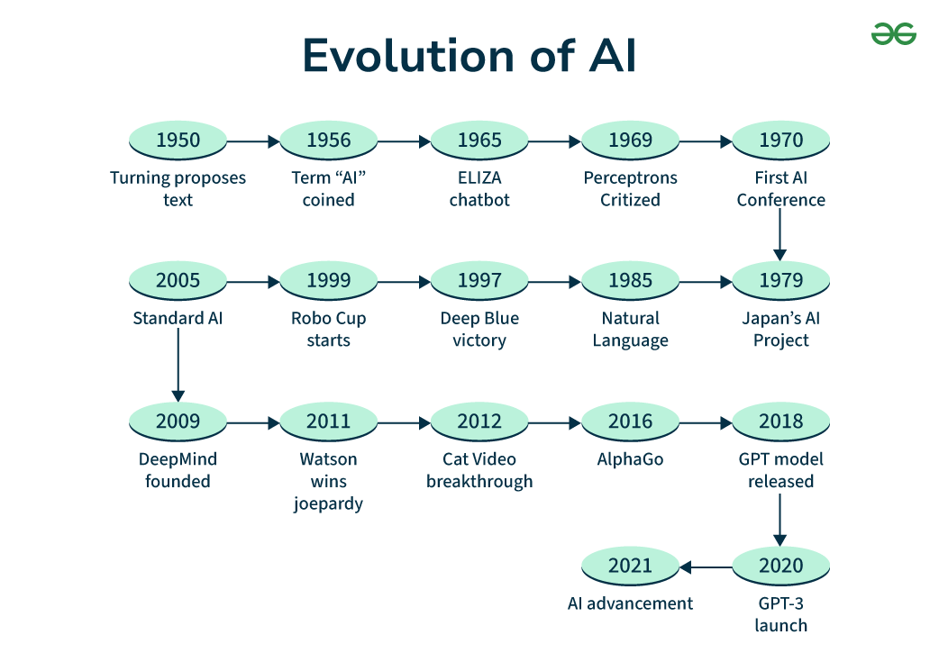
History of Artificial Intelligence
The history and evolution of artificial intelligence (AI) span from early conceptual ideas to today's advanced technologies. AI roots go back to ancient myths about intelligent automatons, but its formal study began in the mid-20th century.

Slide 22
History of Artificial Intelligence
1950: Alan Turing proposed the "Turing Test" as a measure of machine intelligence.
1956: John McCarthy coined the term "Artificial Intelligence" at the Dartmouth workshop, marking AI's birth as a formal discipline.
1950s-60s: Early AI programs like Logic Theorist and ELIZA demonstrated problem-solving and natural language processing.
1980s: AI revival with expert systems focusing on rule-based reasoning.
1997: IBM's Deep Blue defeated world chess champion Garry Kasparov, showing AI's capabilities in complex tasks.
2000s: Growth of machine learning, neural networks, and data-driven AI.
2010s-present: Deep learning and neural networks revolutionized AI, enabling major advancements in image recognition, language translation, and autonomous systems.
2018-2025: Development and widespread use of large language models like GPT series, transforming AI interaction and content generation.

Slide 23
Introduction to Machine Learning
Machine Learning (ML) is a subfield of artificial intelligence (AI) that focuses on developing computer systems that can learn from data and improve their performance over time without being explicitly programmed. Instead of writing step-by-step rules for every task, ML algorithms identify patterns in data and use them to make predictions or decisions.
Why Machine Learning?
Traditional programming fails when tasks are too complex, such as recognizing faces, detecting diseases from images, or predicting customer behavior. Machine learning helps solve such problems by learning patterns automatically.
Key Characteristics of Machine Learning
Data-driven: ML relies on large datasets to learn patterns.
Adaptive: Models improve as they receive more data.
Predictive: ML is used to forecast outcomes (e.g., weather, disease risk).
Automated decision-making: ML supports or replaces human decisions.

Slide 24
Introduction to Machine Learning
How Machine Learning Works (Basic Process)
Collect Data
Prepare and clean the data
Choose an appropriate algorithm
Train the model (learning from data)
Test/evaluate the model
Deploy and use the model for prediction

Slide 25
Types of Machine Learning
1. Supervised Learning
The model learns from labeled data (input + correct output provided).
Used for:
Classification (e.g., identify bacteria species)
Regression (e.g., predicting temperature)
2. Unsupervised Learning
The model learns patterns from unlabeled data.
Used for:
Clustering (group similar data)
Dimensionality reduction (e.g., PCA)
3. Reinforcement Learning
The model learns by interacting with an environment and receiving rewards or penalties.
Used in:
Robotics
Game playing (e.g., AlphaGo)
Autonomous vehicles

